Slide 1





NEXT GEN EMPLOYABILITY PROGRAM
College Name: SRI KRISHNA INSTITUTE OF TECHNOLOGY
Team Name: JAHIRUL HOSSAIN_BATCH-1
https://nextgen.edunetworld.com
nextgenep@edunetfoundation.org

Slide 2
CAPSTONE PROJECT SHOWCASE
Project title: PROFIT ANALYSIS OF GLOBAL SUPERSTORES
Problem Statement| Project Overview| Solution & Proposed Value Proposition | Wow Factor | Modelling & Results | Team Intro | Q&A
Notes:
Let me quickly walk you through the brief plan for today. We are going to discuss the need for this program, what it offers to the students, how it will help you choose a fine career pathway, how to get enrolled in this program and so on….

Slide 3
Problem Statement (1st Page)
Top 5 Products with max sales
In the Dataset, product column is present which is of Text Data Type and sales column are Numerical Data Type . In this column top 5 products are available.
The problem statement here is to know the Top 5 products are max sales in this column using Stacked column chart .
Month wise sales and Profit
In the Dataset, the sales and profit column are Numerical Datatype and month which is of Date Datatype.
The problem statement here is to know the month wise Total sales and profit using Line chart.
Top 5 sub categories by sales
In the Dataset, the sales column which is of Numerical Datatype and Top 5 sub-category wise sales.
The problem statement here is to know Top 5 sub-categories sales using Line and clustered column chart.

Slide 4
Problem Statement (2nd Page)
category vs sales
In the Dataset, the Total sales column are present which is of Numerical Datatype, and its showing sum of sales by category.
The problem statement here is to know the various category wise sales there is shown in this column using Pie chart.
Region wise Profit
In the Dataset, the Total sales column are present which is Numerical Datatype, and its showing sum of profit by region.
The problem statement here is to know the region wise profit there is shown in this column using Clustered column chart.
Top 5 Profitable Products
In the Dataset, the Total profit column are present which is Numerical Datatype, and its showing the Top 5 profitable products.
The problem statement here is to know the Top 5 profitable Products there is shown in this column using Donut chart.

Slide 5
Problem Statement (3rd Page)
Year wise view
In this column showing all types of data visualizations using various categories of chart.
In the problem statement here is to know the year wise various data visualization there is shown in using slicer
Top 10 Region wise Shipping Cost
In the Datatype shipping cost column are present which is of Numerical Datatype and its showing the Top 10 region wise shipping cost.
The problem statement here is to know the Top 10 region wise Shipping cost there is shown in this column using Map.

Slide 6

Project Overview
comprehensive profit analysis: A comprehensive profit analysis involves a detailed assessment of the financial aspects of a business or project. It aims to determine the profitability and financial viability by examining various revenue streams, costs, and financial metrics
Cost of Goods Sold (COGS): Determine the direct costs associated with producing or acquiring the products/services sold, including raw materials, manufacturing costs, and supplier expenses.
Operating Profit Margin: Assess the operating profit margin, which is the difference between gross profit and operating expenses, expressed as a percentage. It reflects the profitability of the core operations before interest, taxes, and non-operating items.
Net Profit Margin: Determine the net profit margin, which is the percentage of net income (after deducting all expenses, taxes, and interest) in relation to total revenue. It indicates the overall profitability of the business.

Slide 7
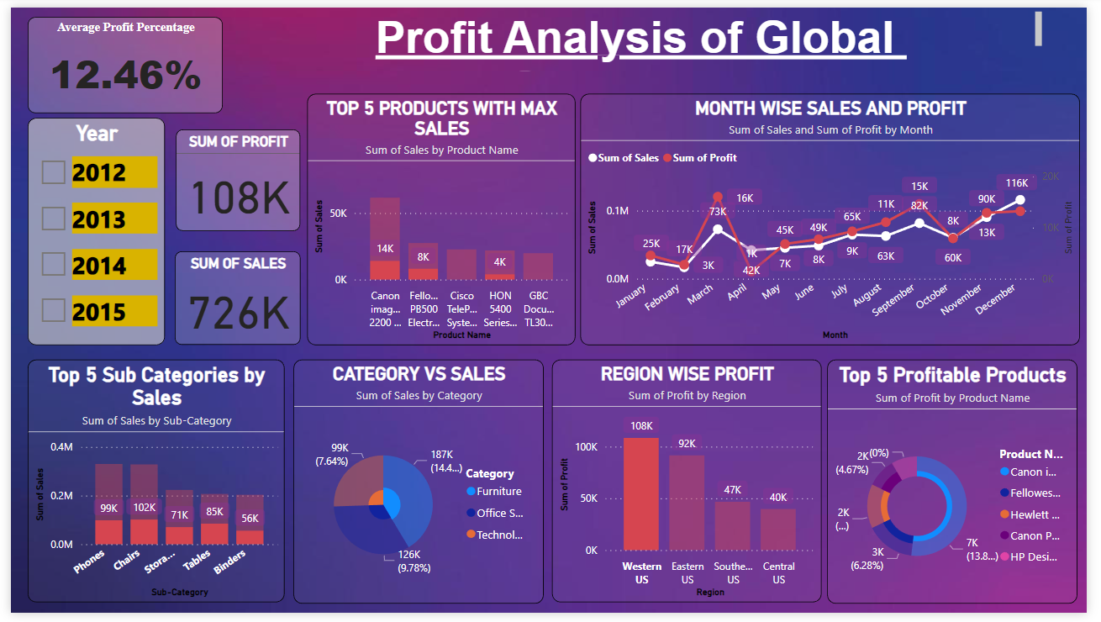
Solution
Proposed Value Proposition

Slide 8
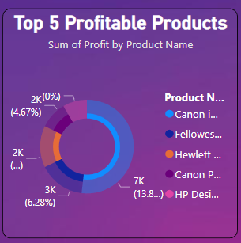
THE WOW in your solution
TOP 5 Profitable products

Slide 9
Modelling & results
Data Gathering: Collect relevant data and information about the global stores project, including market research, cost estimates, revenue projections, and financial statements.
Revenue Projection: Develop a revenue forecast based on market research, target market analysis, and historical sales data (if available). Consider factors such as market size, market share potential, growth rates, and pricing strategies. Incorporate different revenue streams, such as product sales, service fees, and potential partnerships or collaborations.
Cost Estimation: Identify and estimate the various costs associated with the global stores project. This includes initial setup costs (e.g., store construction, equipment, inventory, staffing) and ongoing operational costs (e.g., utilities, maintenance, marketing, employee wages). Consider any region-specific factors, such as currency exchange rates and local regulations that may impact costs.
Financial Projections: Develop a financial model that incorporates the revenue forecast and cost estimates over a specific time horizon (e.g., five to ten years). This model should account for factors like seasonality, market trends, and potential growth opportunities. Use appropriate financial techniques, such as discounted cash flow (DCF) analysis, to calculate the present value of future cash flows.
Financial Metrics: Calculate financial metrics to evaluate profitability, such as net present value (NPV), return on investment (ROI), internal rate of return (IRR), and payback period. These metrics help assess the project's financial attractiveness and compare it against the company's investment criteria.
Risk Assessment: Identify potential risks and uncertainties that may affect profitability, such as economic fluctuations, regulatory changes, competitive pressures, and supply chain disruptions. Quantify and assess these risks, and consider incorporating them into the financial model through scenario analysis or risk-adjusted discount rates.

Slide 10
Meet our team
Mentor Name
NARENDRA ELURI
Group Leader
JAHIRUL HOSSAIN
Group Member
Sushma Karjol
Group Member
Ruthika M T
Group Member
Sneha N
Group Member
Shubhash Chandra Yadav

Slide 11


Any
questions/comments?

